Slide 1
Bayesian Inference and the MNIST dataset
Bilal Ullah

Slide 2



Use Case Summary
Problem
Teachers spend a lot of time marking papers and logging results
Solution
Apply Bayesian Inference to log scores from marked papers

Slide 3
How can we achieve this?
Apply Non Bayesian Inference to train MNIST dataset
Use this model to predict the output from this dataset to a high standard
Apply in real life scenario

Slide 4
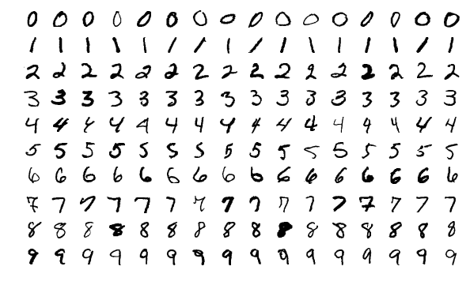
MNIST dataset
The MNIST database (Modified National Institute of Standards and Technology database) is a large database of handwritten digits

Slide 5
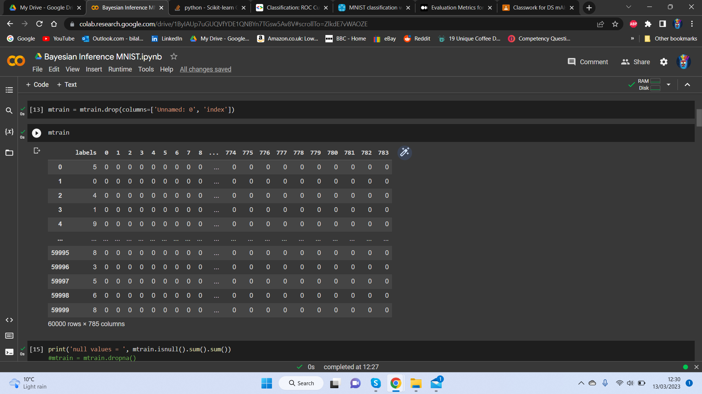
Data

Slide 6
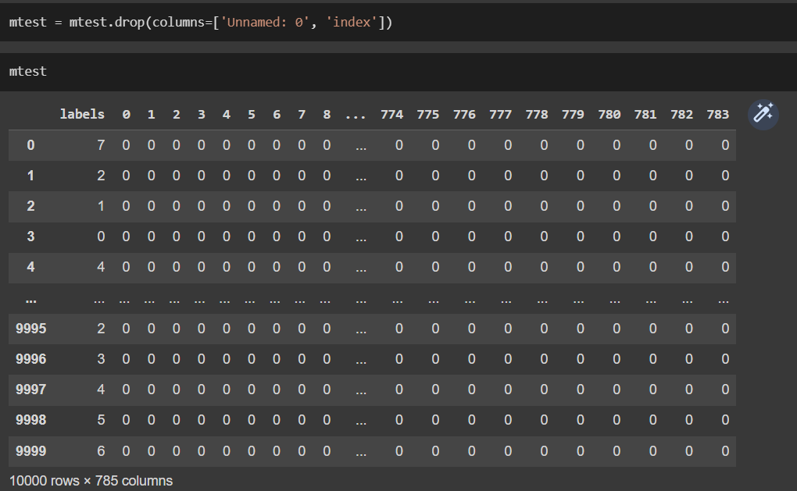
Data

Slide 7
Model Selection
Gaussian Naïve Bayes Classifier
Naive Bayes assumes the input features (predictors) are not correlated.
KNN Classifier
Time
Cost of computation power
Non-Naïve Bayes Classifier
Used for multinomially distributed data. This is suitable for classification with discrete features

Slide 8
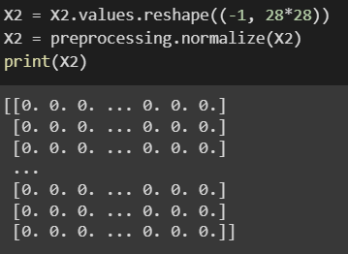
Normalize Data
Normalization is the process of scaling individual samples to have unit norm.
Data was also reshaped to fit the model requirements

Slide 9
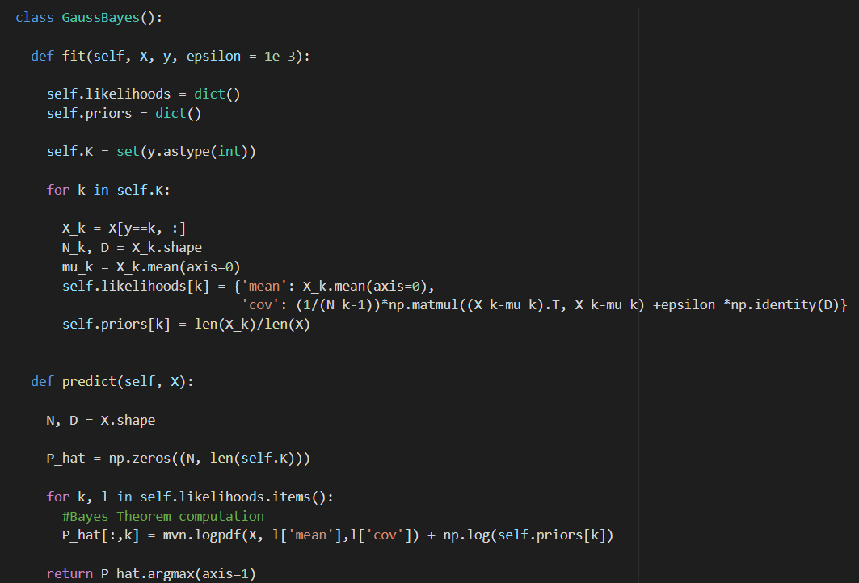
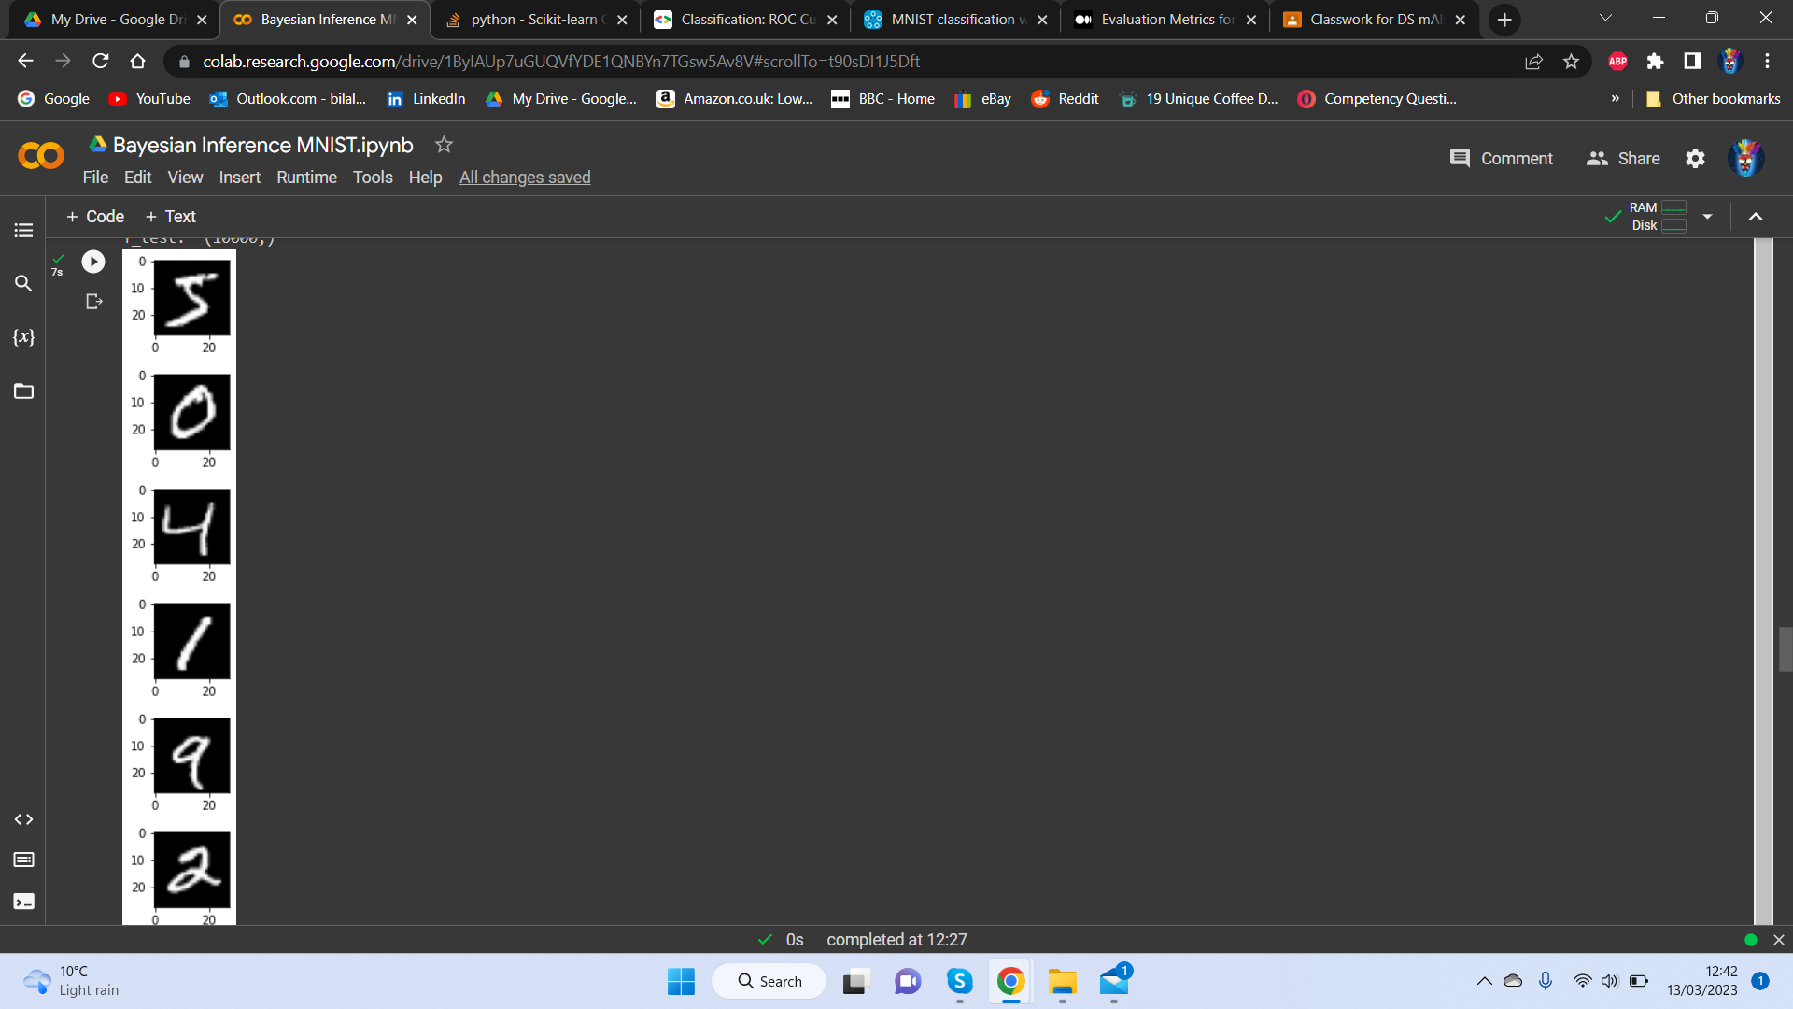
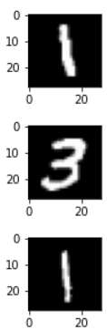
Training the Model
Example of the data as images

Slide 10
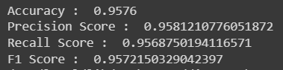
Model Evaluation
Accuracy - the ratio of the total number of correctly predicted samples by the total number of samples
Precision - out of total predicted positive values how many were actually positive
Recall - the ratio of true positives by the sum of true positives and false negatives
F1 Score - F1 score is derived from F Beta Score. F Beta score is the weighted harmonic mean of precision and recall

Slide 11
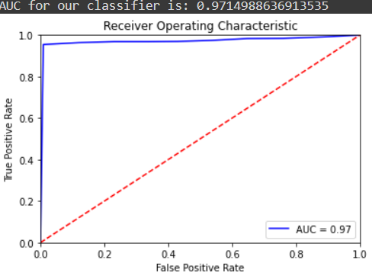
AUC: Area Under the ROC Curve
The ROC curve is plotted between True Positive Rate (TPR) and False Positive Rate (FPR)

Slide 12
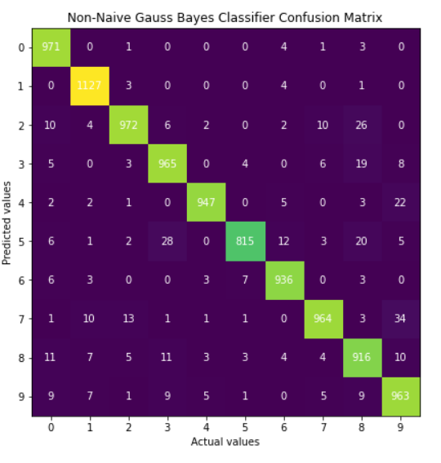
Confusion Matrix
Visual representation of Predictions and actual Values

Slide 13
Conclusion
Recommended for daily use by teachers
Cost effective
Time efficient
Scored well across all metrics
For official tests, further research/optimization is advised

Slide 14
Thanks For Listening!

Slide 15
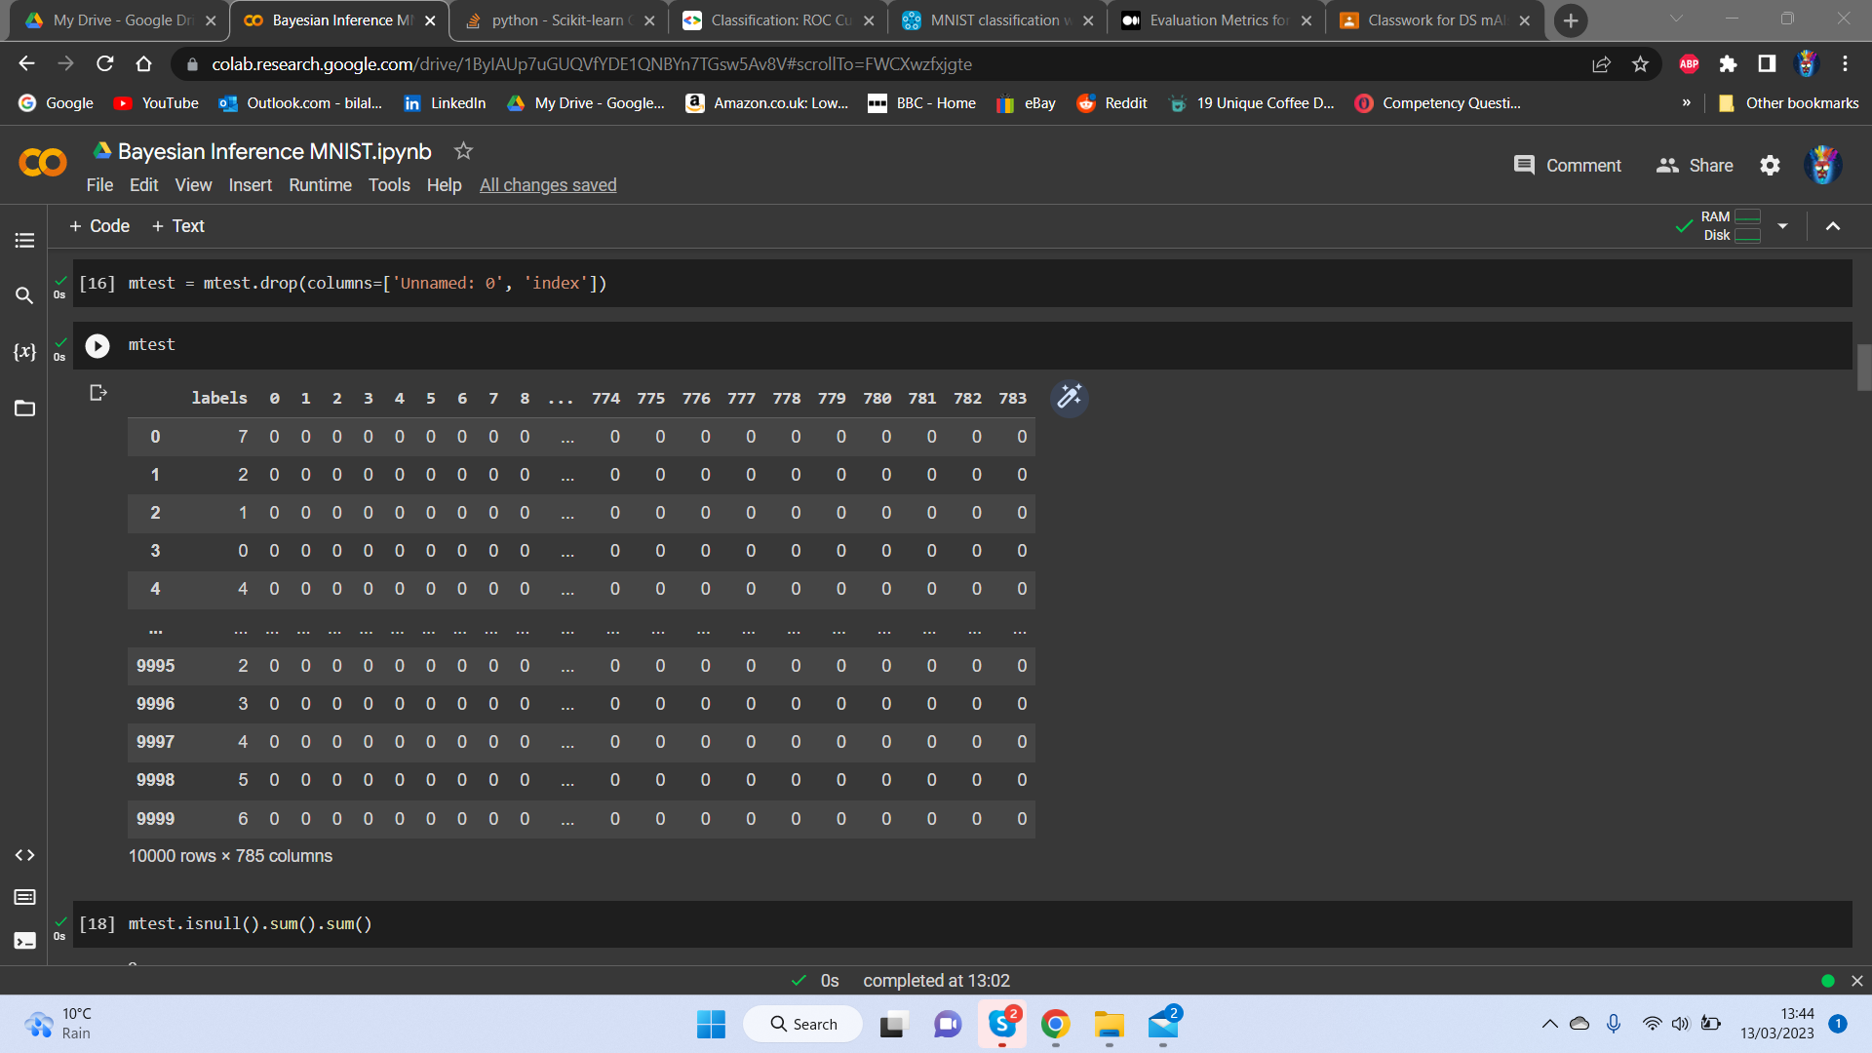
Appendix

Slide 16
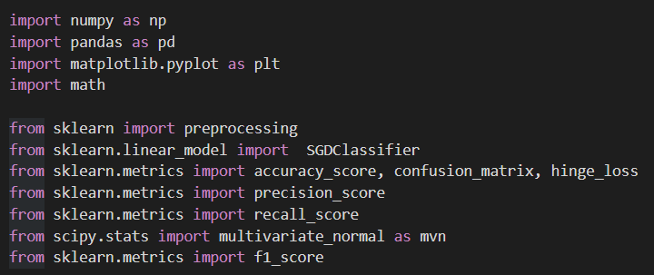
Libraries

Slide 17
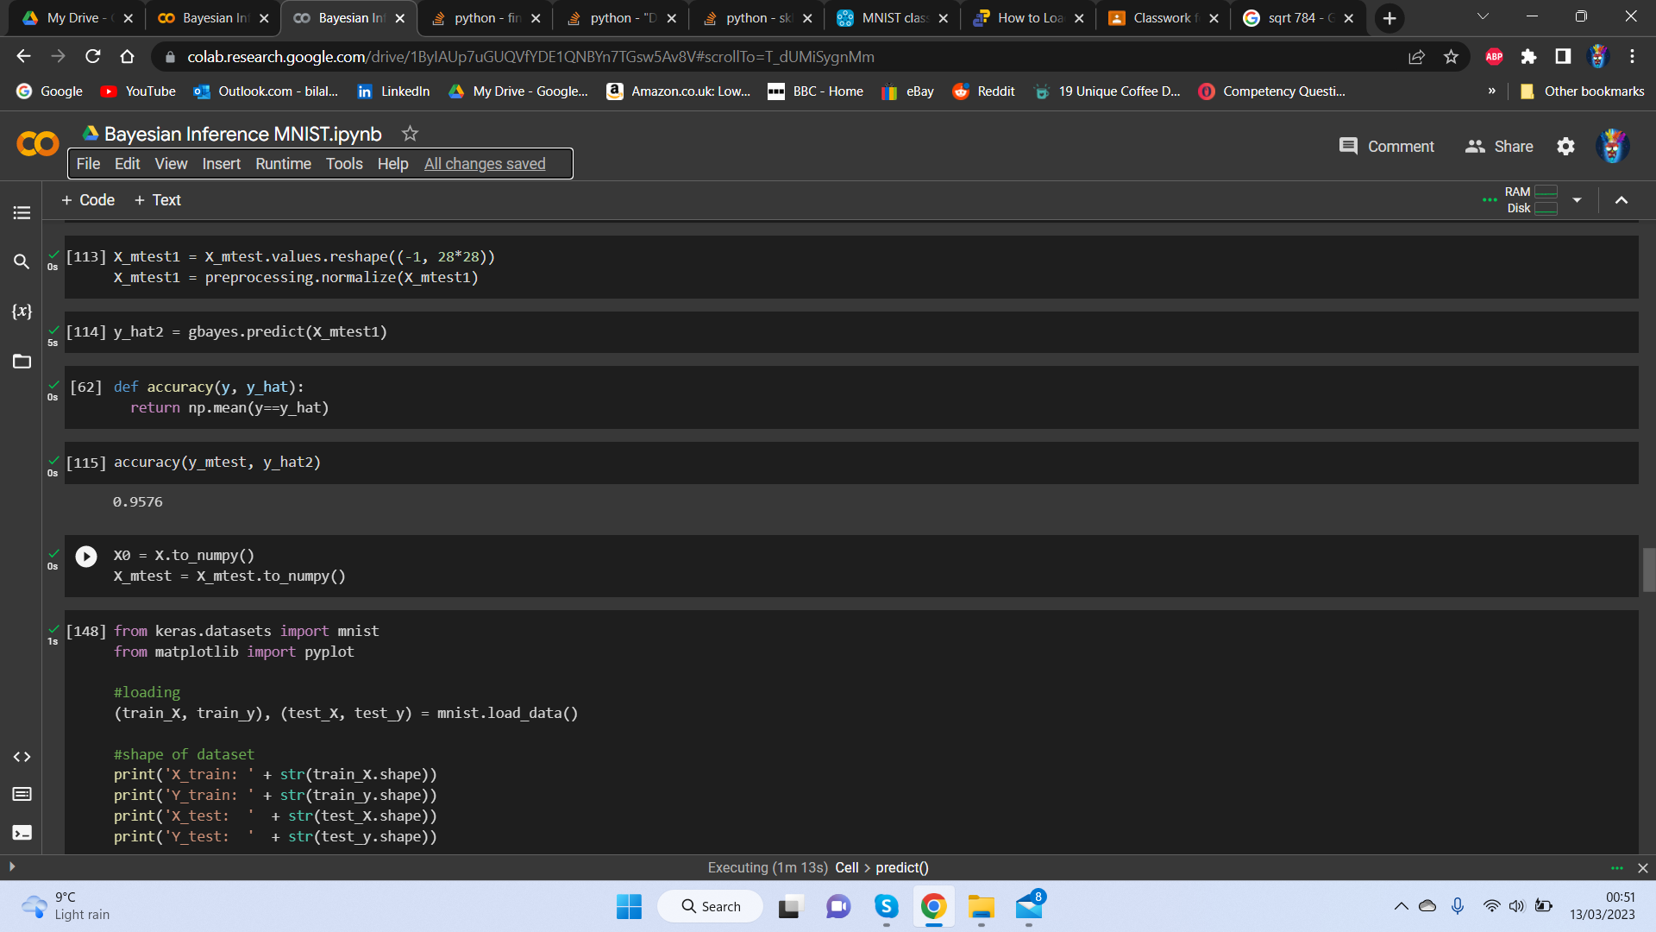

Slide 18
